Slide 1
Kb-pgt-1 learning tool for automata inference using animation or 3D
Supervisor: Dr KE Bogdanov
Student: SiYuan Yu

Slide 2
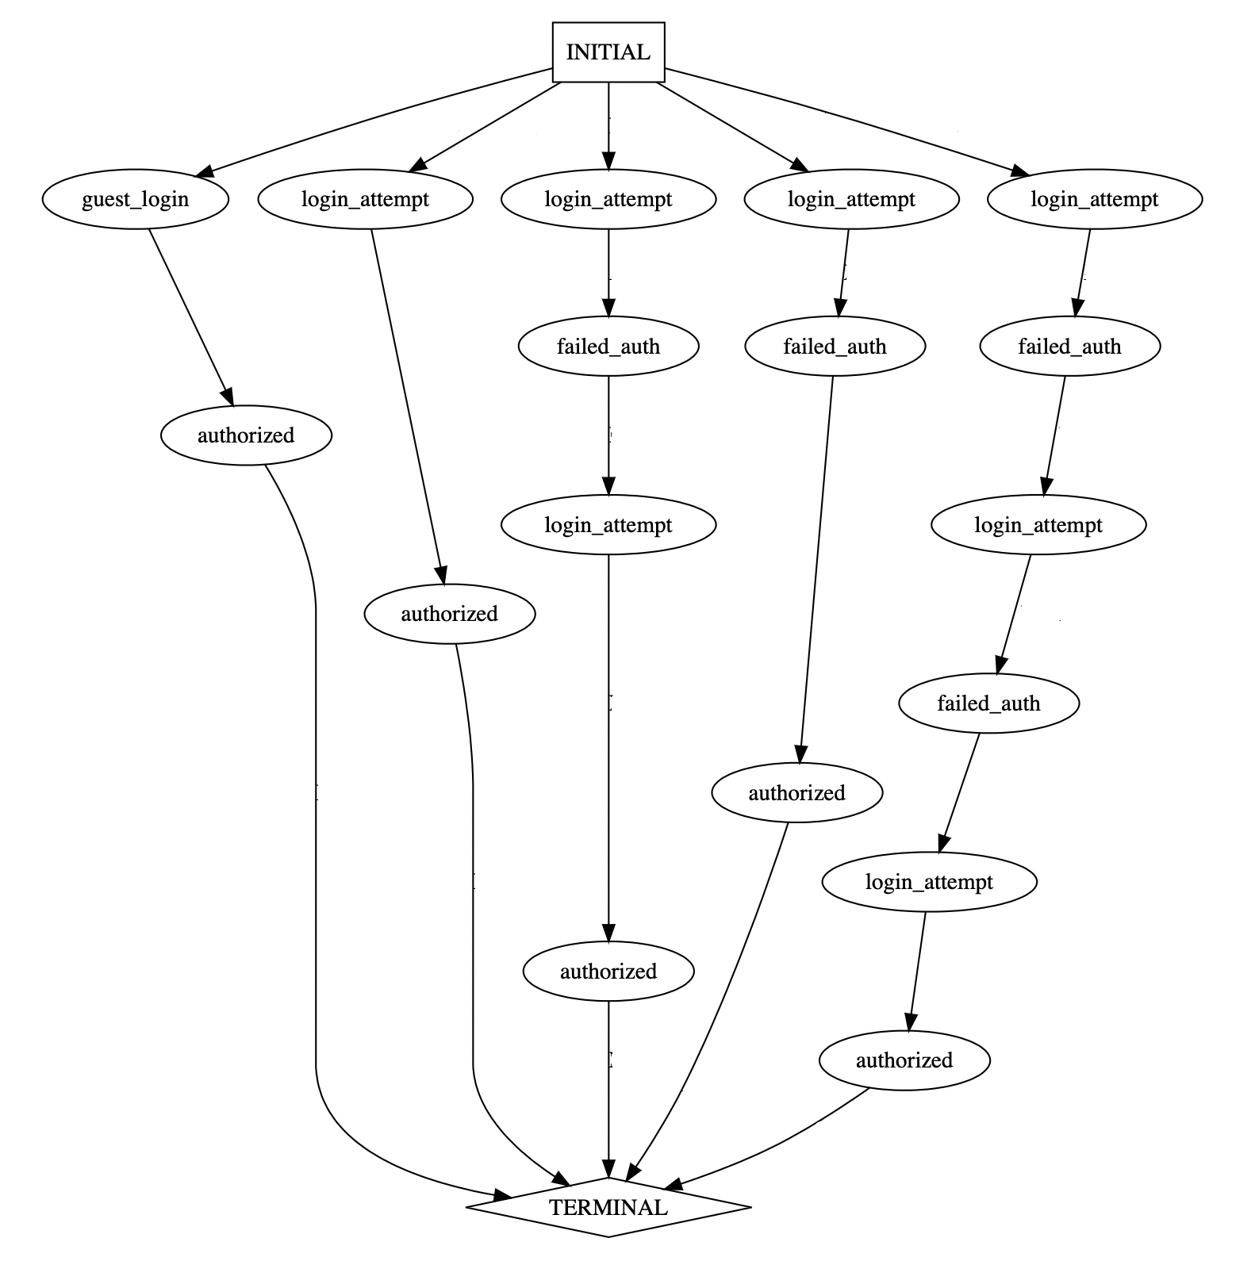
1, Background and problems
1, background and problem
2, K-tails algorithm
3, Design
4, Implementation
5, Evaluation
Simulating software behavior is an integral step in the process of software reverse engineering.
Advantages: 1, understand a complex software behavior in a short time; 2, easier to optimize functions and find errors
Problem: 1, long time to model; 2, software evolution.
Therefore, the learning tool aim to help users understand software behavior by user interaction and avoid the obstacles caused by software iteration to model building.
prefix-tree acceptor

Slide 3
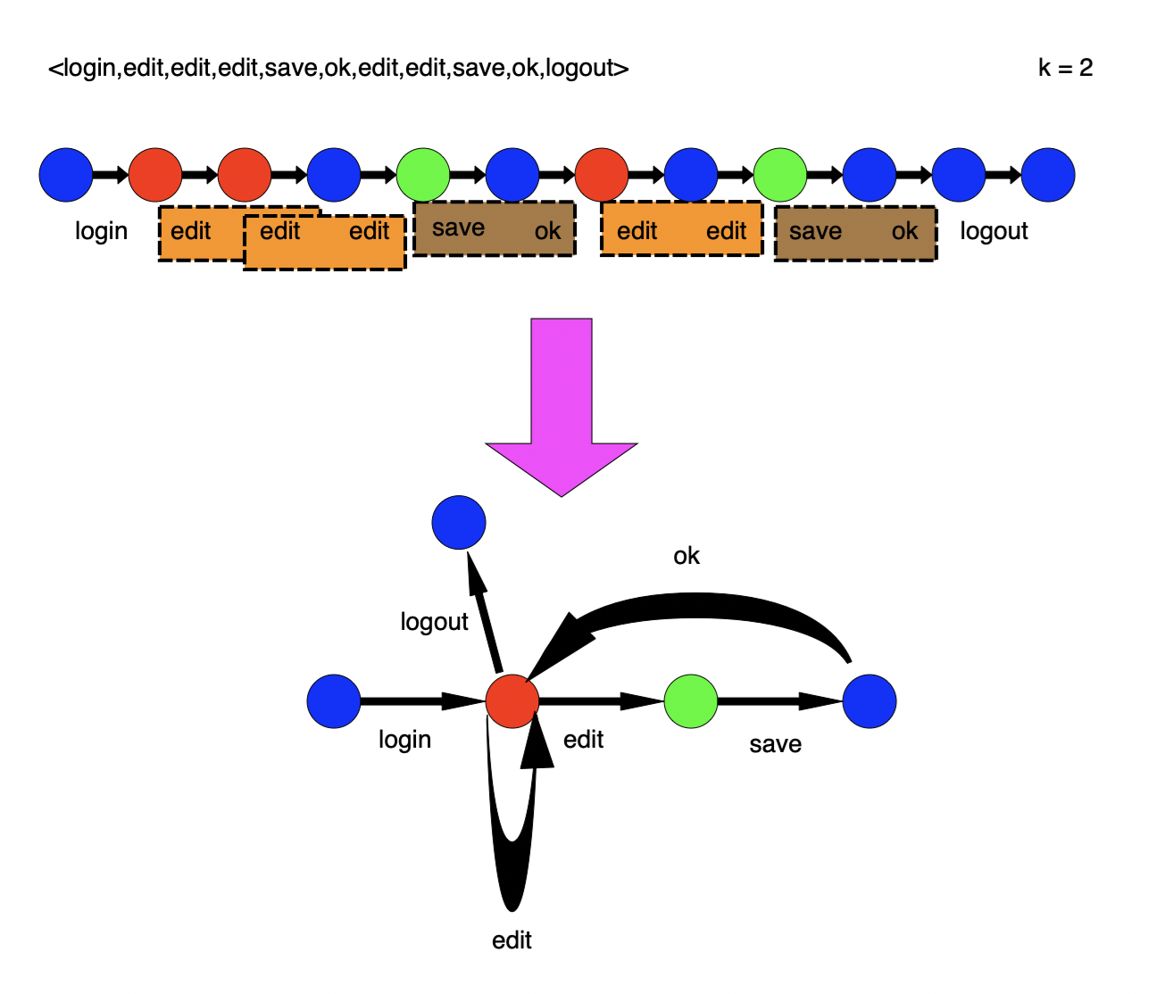
2, K-tails algorithm
1, background and problem
2, K-tails algorithm
3, Design
4, Implementation
5, Evaluation
K-tails algorithm use k to limit the number of events and functions. After that we could merge similar traces with the same k.

Slide 4
3, Design
1, background and problem
2, K-tails algorithm
3, Design
4, Implementation
5, Evaluation
traces
prefix-tree acceptor
states
PYGRAPHVIZ
PYQT5
PYQT5
UI
PYGRAPHVIZ
Draw trees
Run finite automaton

Slide 5
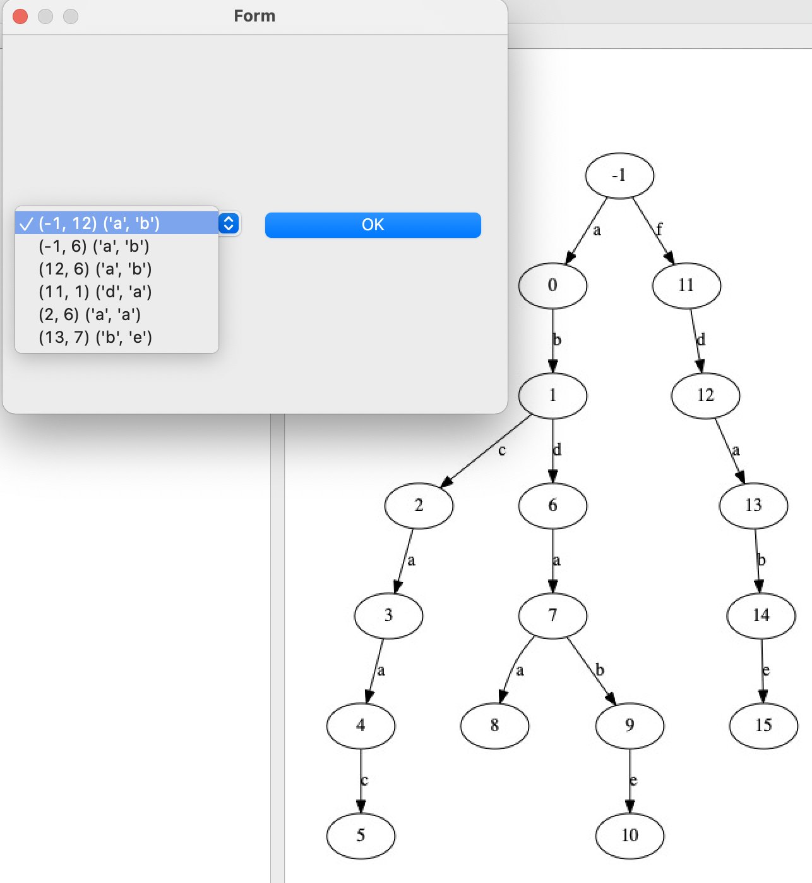
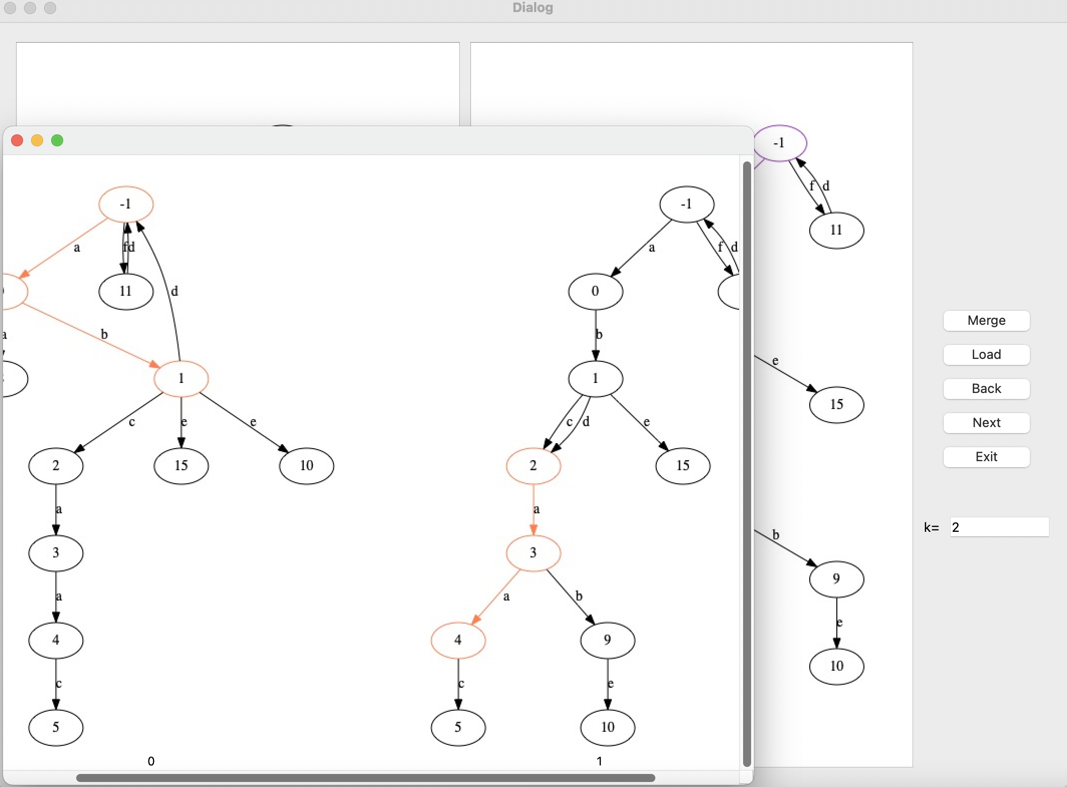
4, Implementation
1, background and problem
2, K-tails algorithm
3, Design
4, Implementation
5, Evaluation
Run finite automaton
Based on the value of k find and save the whole states like
K=2;[a,a]{[2,6],[4,8]}
Choose the begin of tree
When you merge by yourself, if you want to start by the last trace, you could click back and then click Next to choose whether start with merged trace or last trace.
History
The return button is strongly associated with a tree called history in the code. I save the tree of all the branches that appear in the history tree(graph on the right).
But you need notice that any branches can only have one father.
History tree
tree1
tree2
tree3
tree4
tree5
tree6

Slide 6
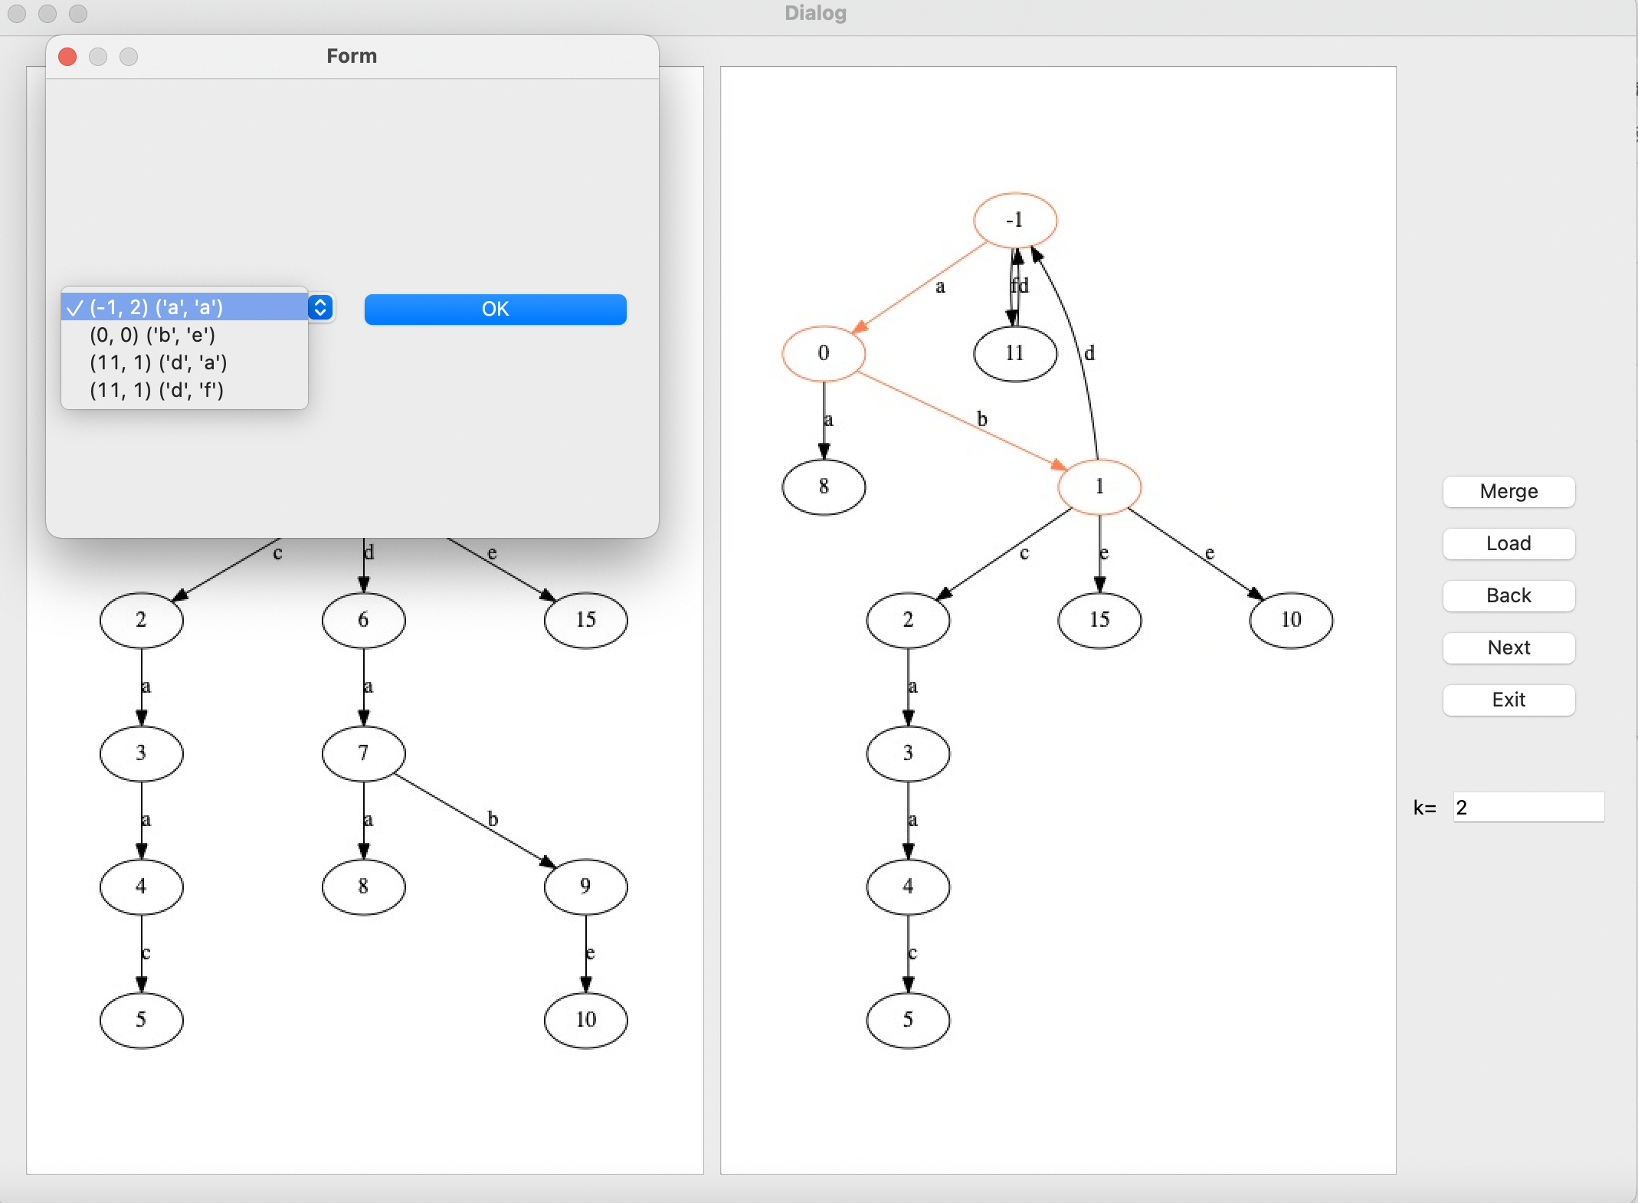
5, Evaluation
1, background and problem
2, K-tails algorithm
3, Design
4, Implementation
5, Evaluation
1, two screens enable users to acknowledge how k-tails merge traces
2, each merged states are marked with eye-catching color
3, user could merge any mergeable states at any time
4, user could see the whole mergeable command strings and states

Slide 7

Thank you

